Slide 1
Lecture Notes on Mathematical Morphology: The Median Filter

Slide 2
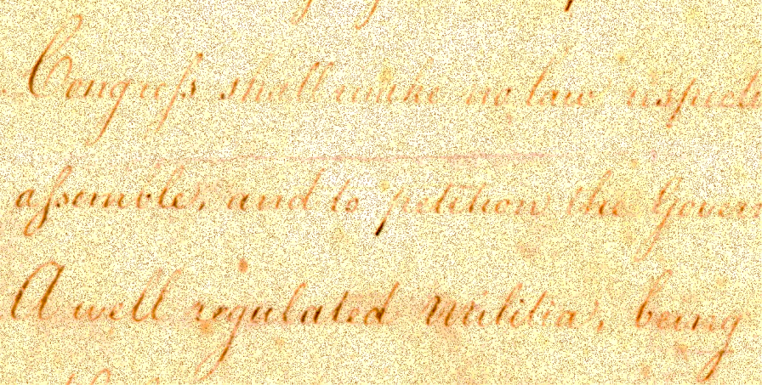
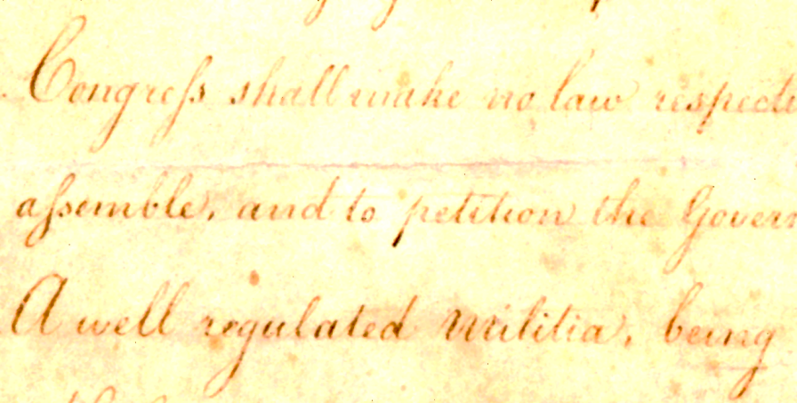
The Median Filter
Returns the median value of the pixels in a neighborhood
Is non-linear
Is a morphological filter
Is similar to a uniform blurring filter which returns the mean value of the pixels in a neighborhood of a pixel
Unlike a mean value filter the median tends to preserve step edges
original
median filtered

Slide 3
Median Filter: General Definition
This can be computed as follows:
Let I be a monochrome (1-band) image.
Let Z define a neighborhood of arbitrary shape.
At each pixel location, p = (r,c), in I …
… select the n pixels in the Z-neighborhood of p,
… sort the n pixels in the neighborhood of p, by
The output value at p is L(m), where m = n/2✗+1.
value, into a list L( j) for j = 1,…,n.

Slide 4
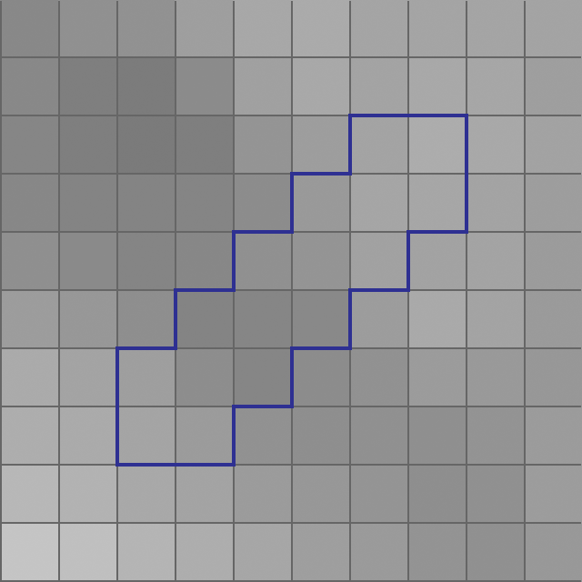
Median Filter: General Definition
131
133
133
136
140
143
147
152
154
157
160
162
163
164
165
171
sorted intensity values from neighborhood of p.
p
median assigned to pixel loc p in output image.

Slide 5
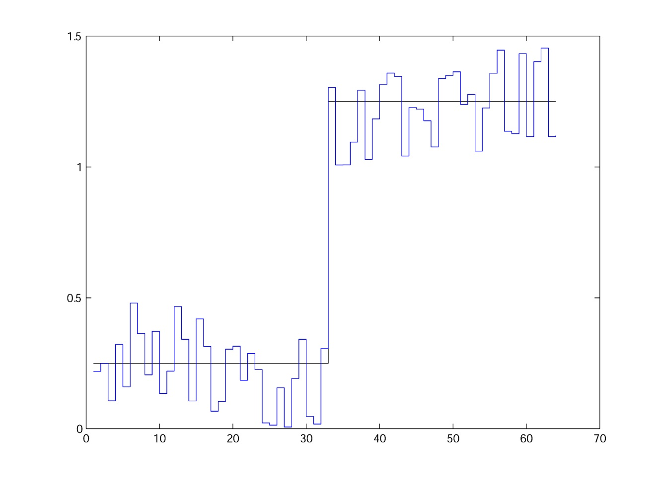
A Noisy Step Edge

Slide 6
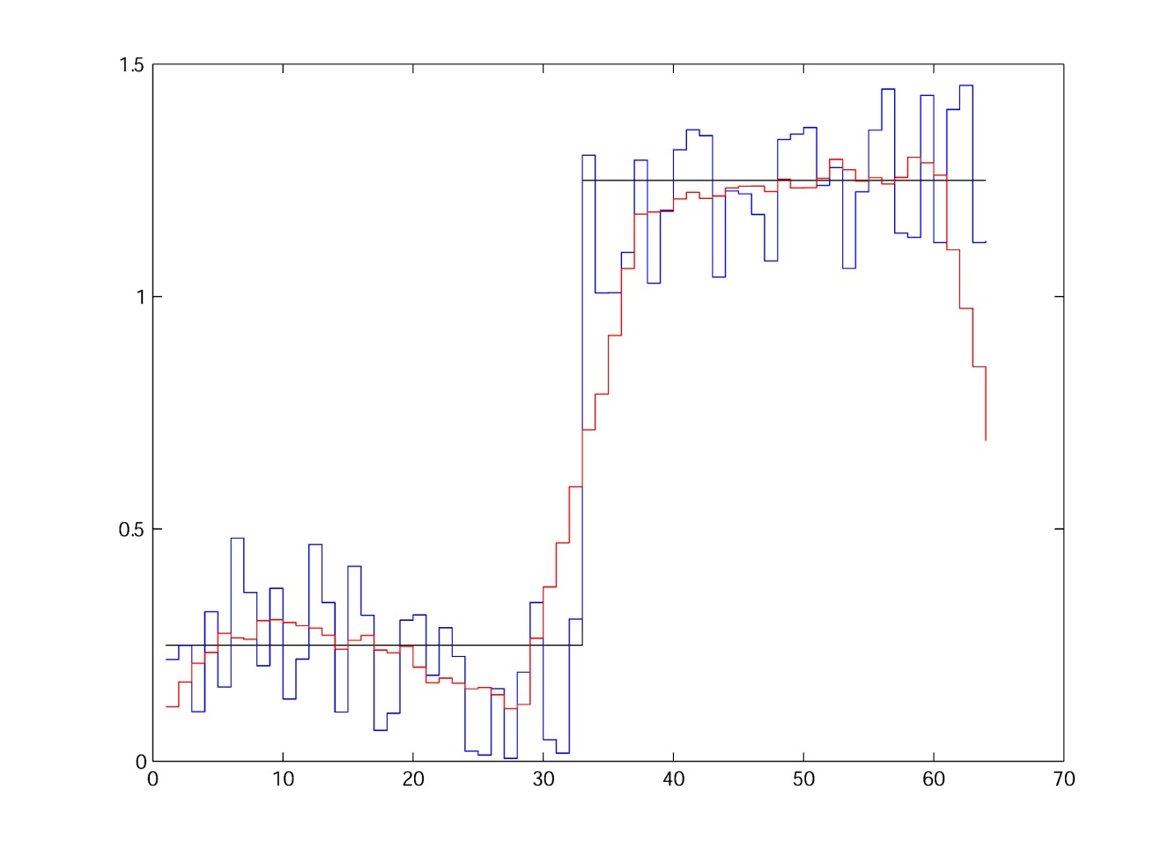
Blurred Noisy 1D Step Edge

Slide 7
Blurred Noisy 1D Step Edge
J(32-4:32+4)=
0.1920
0.3416
0.0464
0.0177
0.3062
1.3043
1.0079
1.0082
1.0950
mean
0.5910
J(33-4:33+4)=
0.3416
0.0464
0.0177
0.3062
1.3043
1.0079
1.0082
1.0950
1.2935
mean
0.7134

Slide 8
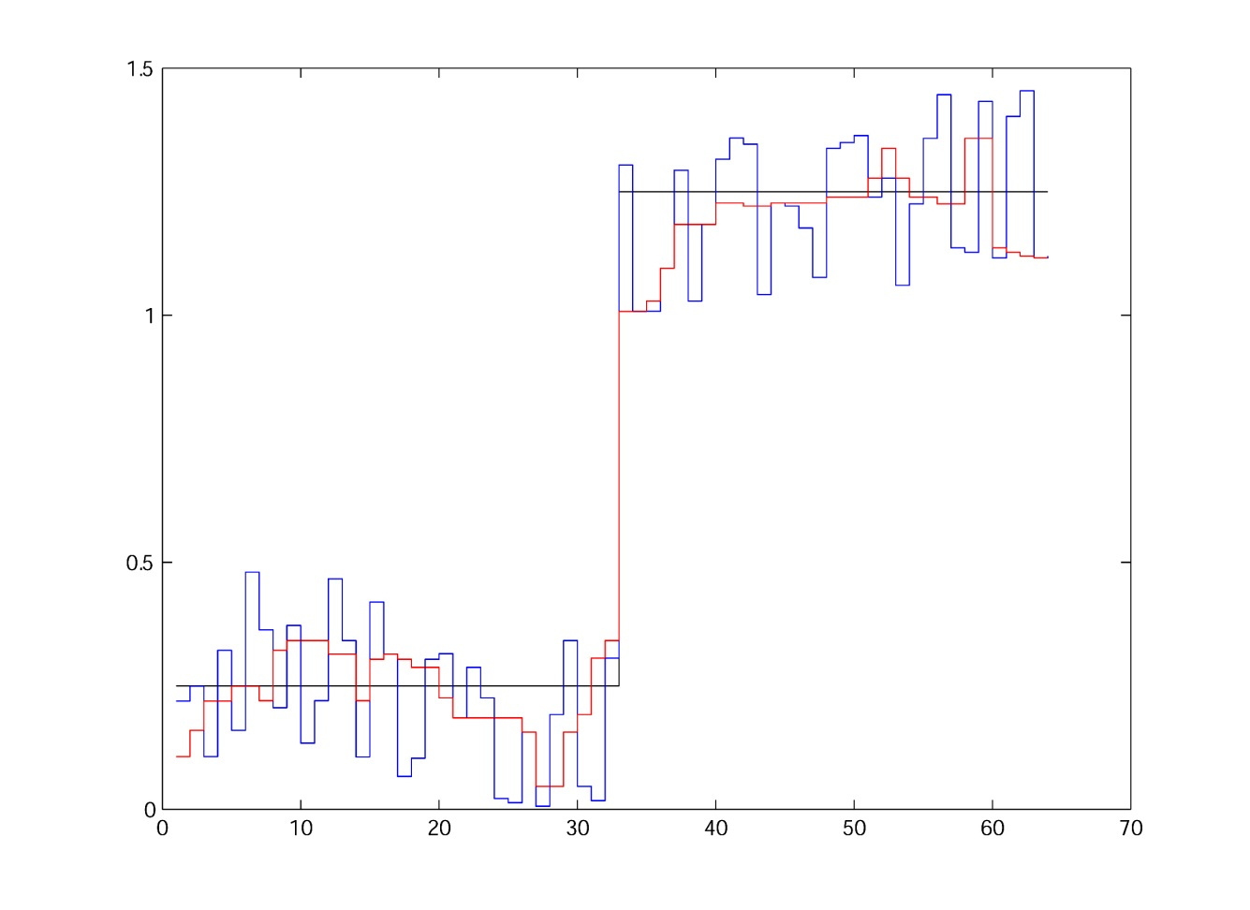
Median Filtered Noisy 1D Step Edge

Slide 9
Median Filtered Noisy 1D Step Edge
J(32-4:32+4)=
0.1920
0.3416
0.0464
0.0177
0.3062
1.3043
1.0079
1.0082
1.0950
sorted
0.0177
0.0464
0.1920
0.3062
0.3416
1.0079
1.0082
1.0950
1.3043
median
sorted
J(33-4:33+4)=
0.3416
0.0464
0.0177
0.3062
1.3043
1.0079
1.0082
1.0950
1.2935
0.0177
0.0464
0.3062
0.3416
1.0079
1.0082
1.0950
1.2935
1.3043
median

Slide 10
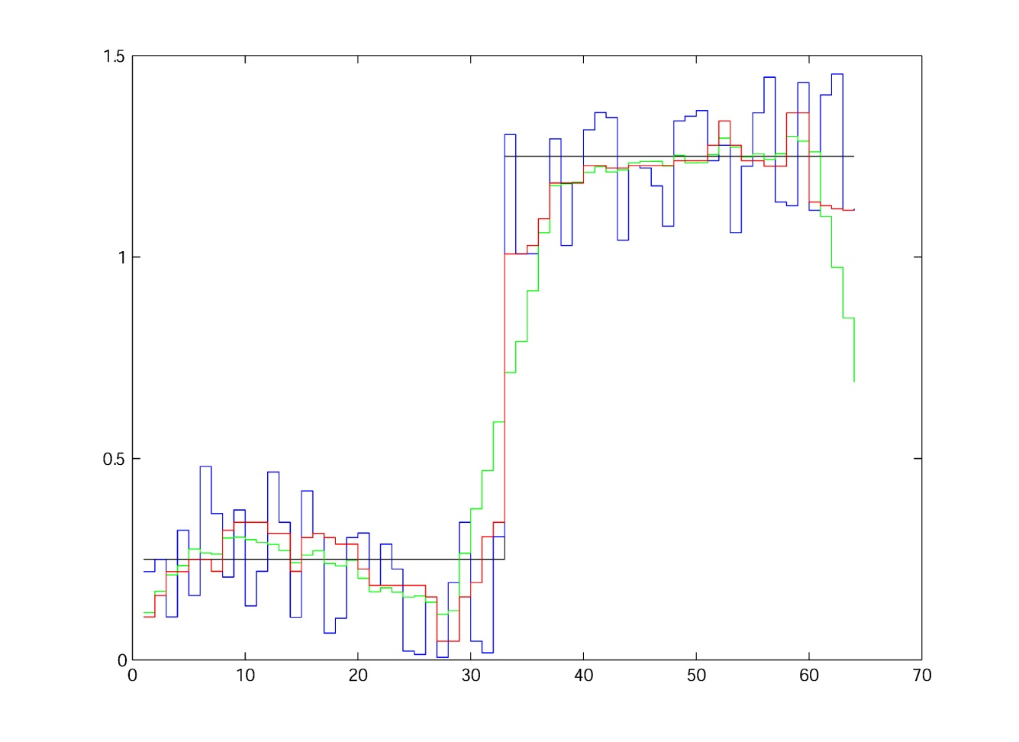
Median vs. Blurred
The median filter preserves the step edge better than the blurring filter.
median
blurred
noisy
step

Slide 11
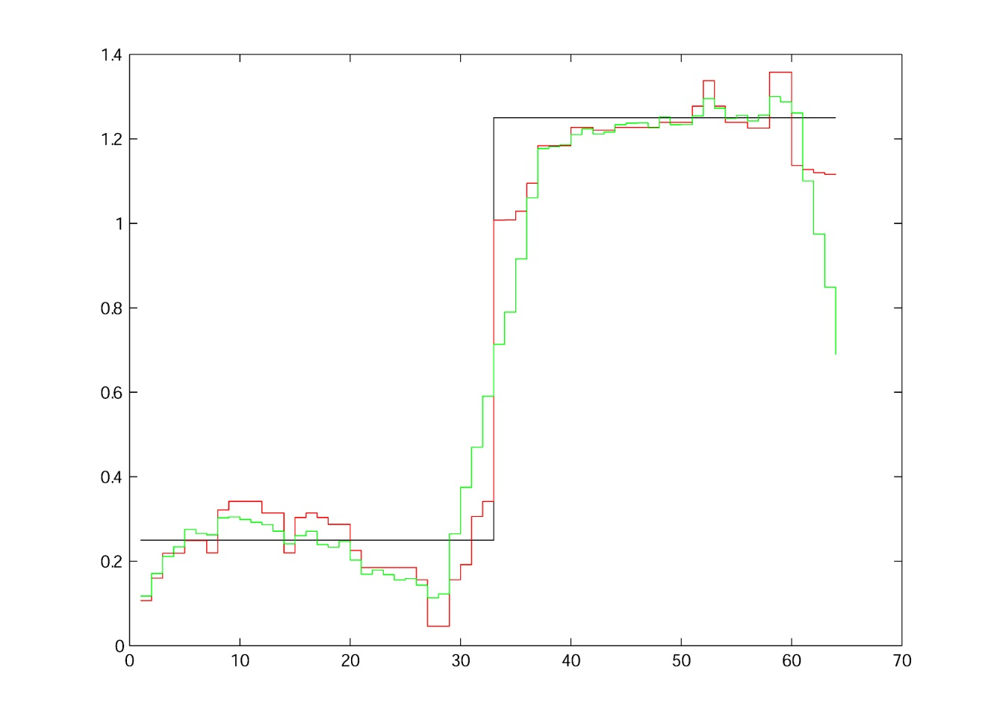
Median vs. Blurred
The median filter preserves the step edge better than the blurring filter.
blurred
median
step

Slide 12
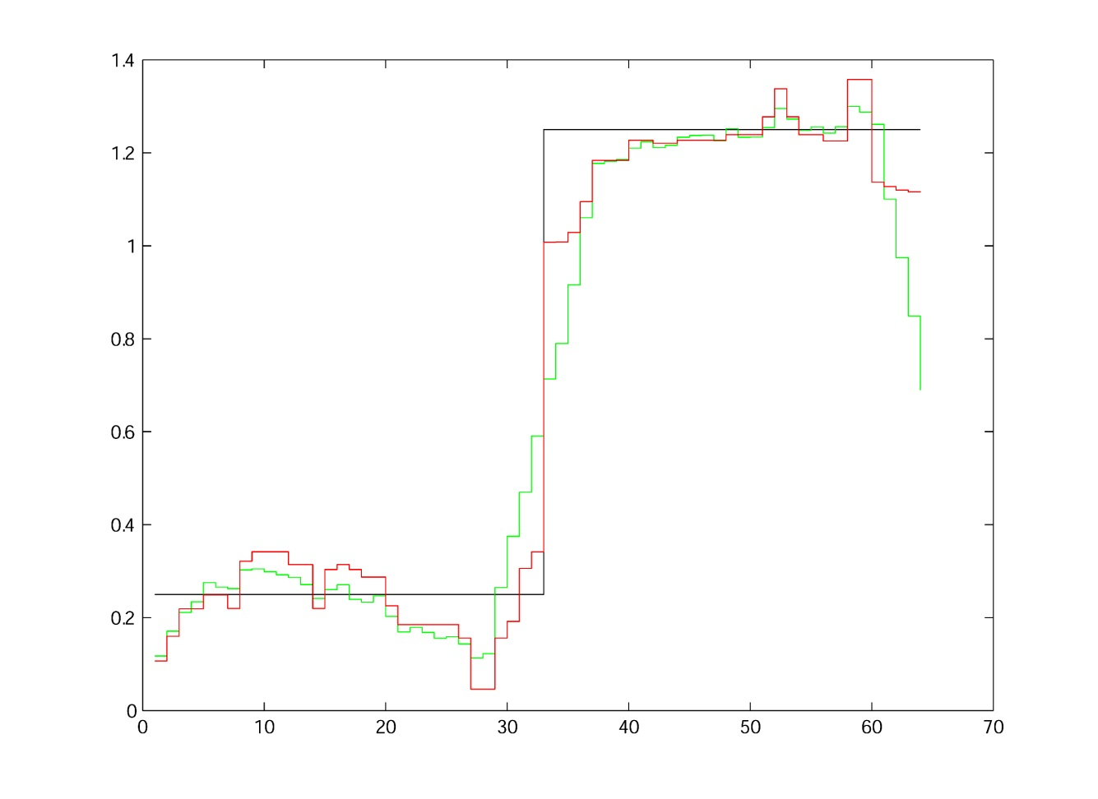
Median vs. Blurred
The median filter preserves the step edge better than the blurring filter.
median
blurred
step

Slide 13
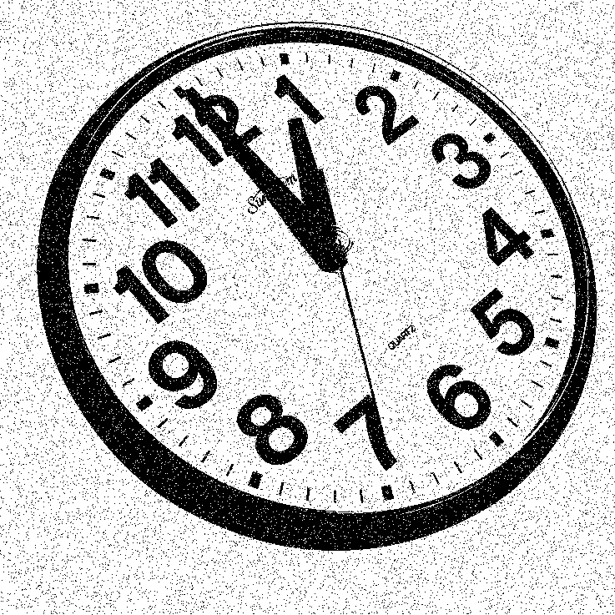

Median Filtering of Binary Images
Noisy
Original

Slide 14
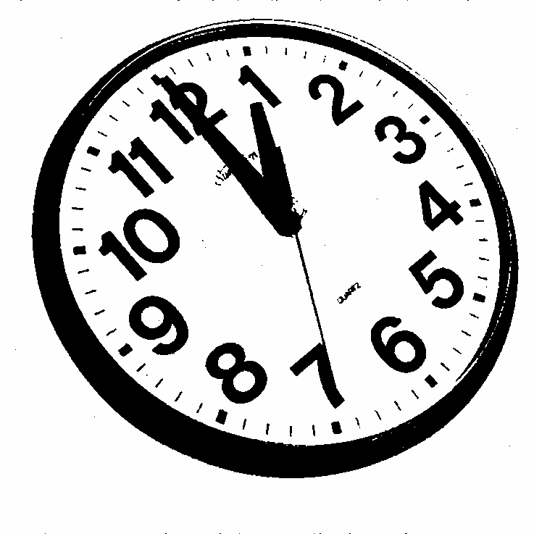
Median Filtering of Binary Images
Median Filtered Noisy
Original

Slide 15
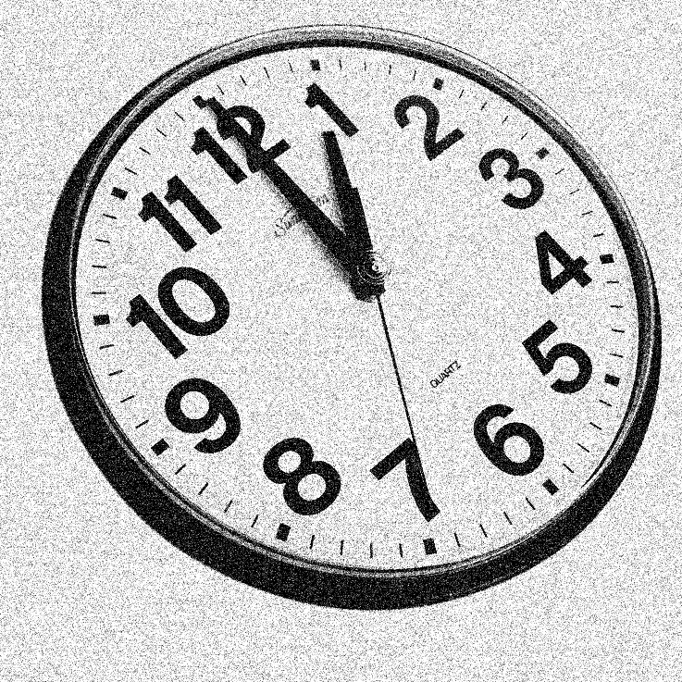
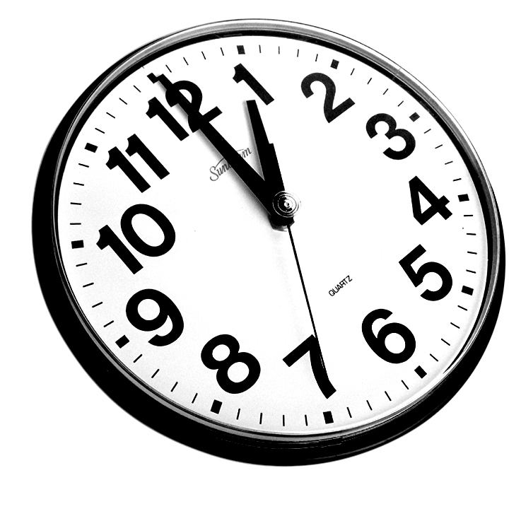
Filtering of Grayscale Images
Noisy
Original

Slide 16
Filtering of Grayscale Images
Noisy
Noisy

Slide 17
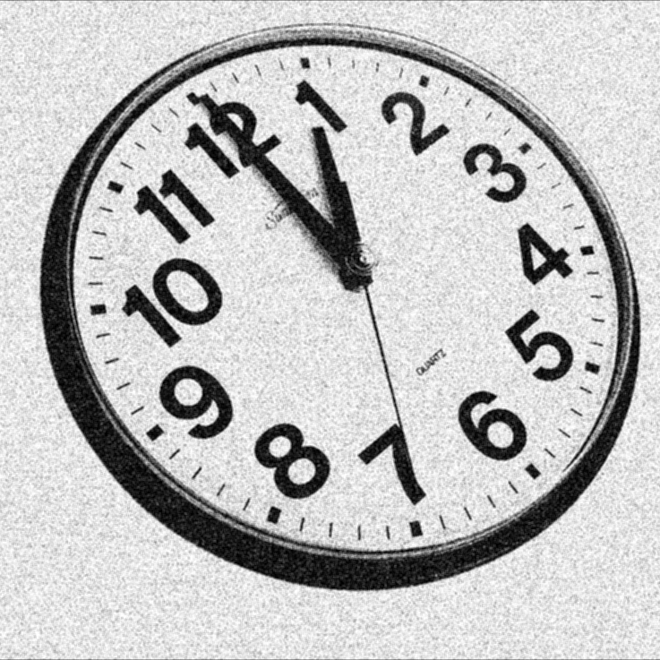

Filtering of Grayscale Images
3x3-blur x 1
3x3-median x 1

Slide 18


Filtering of Grayscale Images
3x3-blur x 2
3x3-median x 2

Slide 19


Filtering of Grayscale Images
3x3-blur x 3
3x3-median x 3

Slide 20


Filtering of Grayscale Images
3x3-blur x 4
3x3-median x 4

Slide 21


Filtering of Grayscale Images
3x3-blur x 5
3x3-median x 5

Slide 22


Filtering of Grayscale Images
3x3-blur x 10
3x3-median x 10

Slide 23
Filtering of Grayscale Images
Noisy
Noisy

Slide 24
Limit and Root Images
Fact: if you repeatedly filter an image with the same blurring filter or median filter, eventually the output does not change. That is, let
Then
where n and m are integers (< ∞) , I₀ is a single-valued image and I_{r} is called the median root of I.

Slide 25
Limit and Root Images
3x3-blur x 10
3x3-median x 10

Slide 26

Limit and Root Images
3x3-blur x n
3x3-median root

Slide 27
Median Filter Algorithm in Matlab
function D = median_filt(I,SE,origy,origx)
[R,C] = size(I); % assumes 1-band image
[SER,SEC] = size(SE); % SE < 0  not in nbhd
N = sum(sum(SE>=0)); % no. of pixels in nbhd
A = -ones(R+SER-1,C+SEC-1,N); % accumulator
n=1; % copy I into band n of A for nbhd pix n
for j = 1 : SER % neighborhood is def’d in SE
for i = 1 : SEC
if SE(j,i) >= 0 % then is a nbhd pixel
A(j:(R+j-1),i:(C+i-1),n) = I;
n=n+1; % next accumulator band
end
end
end
% pixel-wise median across the bands of A
A = shiftdim(median(shiftdim(A,2)),1);
D = A( origy:(R+origy-1) , origx:(C+origx-1) );
return;

Slide 28
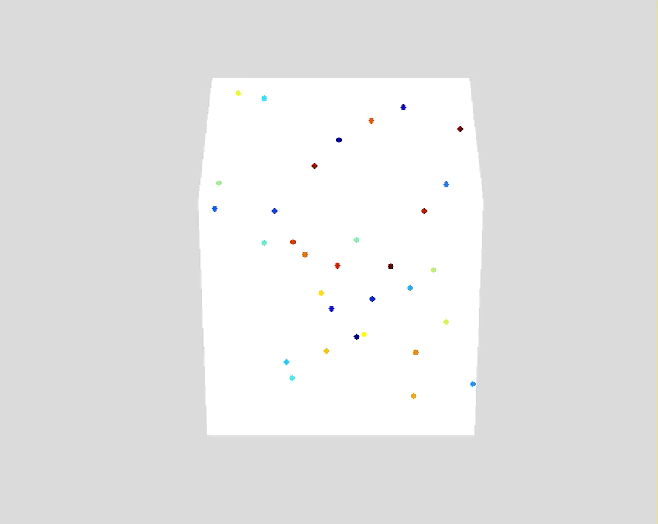
Vector Median Filter
A vector median filter selects from among a set of vectors, the one vector that is closest to all the others.
That is, if S is a set of vectors, in F^{n} the median, v, is♠
♠F^{n} is an n-dimensional linear vector space over the field, F.)

Slide 29
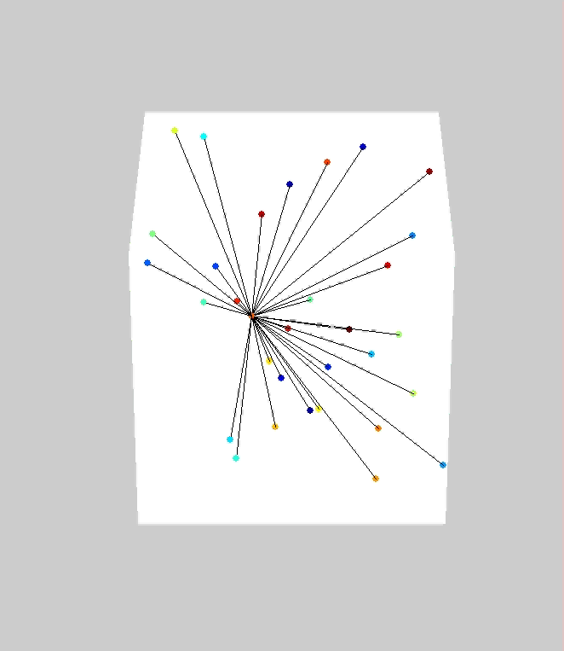
Vector Median Filter
A vector median filter selects from among a set of vectors, the one vector that is closest to all the others.
That is, if S is a set of vectors, in F^{n} the median, v, is♠
♠F^{n} is an n-dimensional linear vector space over the field, F.)

Slide 30
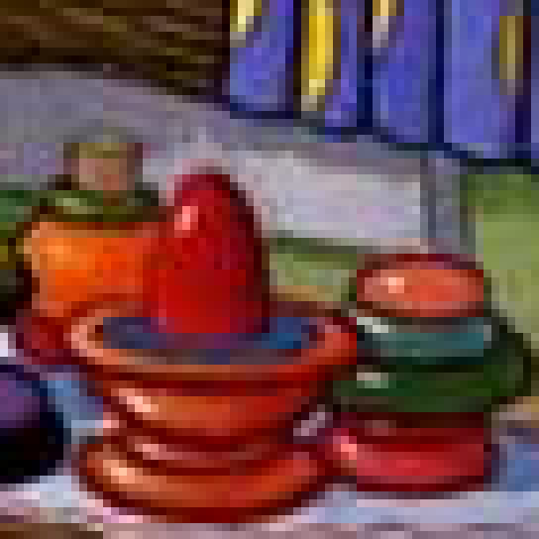
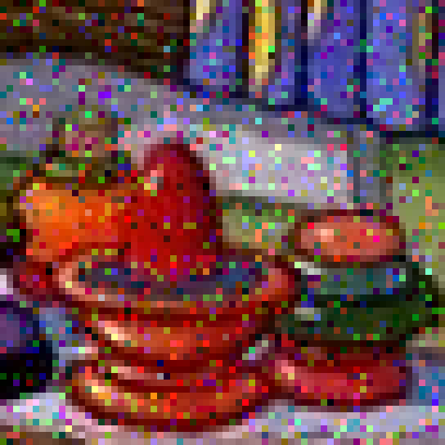


Color Median Filter
If we let F^{n} = R³ then the vector median can be used as a color median filter.
(a)
(b)
(c)
(d)
(a) original image
(b) image (a) with sparse noise
(c) image (b) color median filtered
(d) image (c) color median filtered
Median filter performed on 3×3 nbhd.
original image: Jim Woodring
www.jimwoodring.com

Slide 31
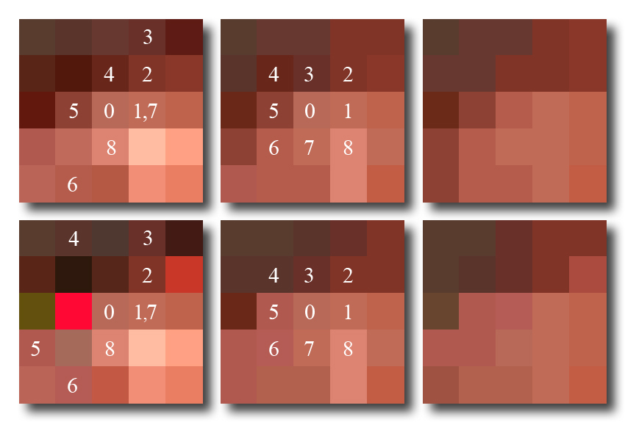
Color Median Filter
The output color at (r,c) is always selected from a nbhd of (r,c) in the input image.
original
3×3 MF
(3×3 MF)²
noisy
3×3 MF
(3×3 MF)²

Slide 32
Color Median Filter
The output color at (r,c) is always selected from a nbhd of (r,c) in the input image.
original
3×3 MF
(3×3 MF)²
noisy
3×3 MF
(3×3 MF)²

Slide 33
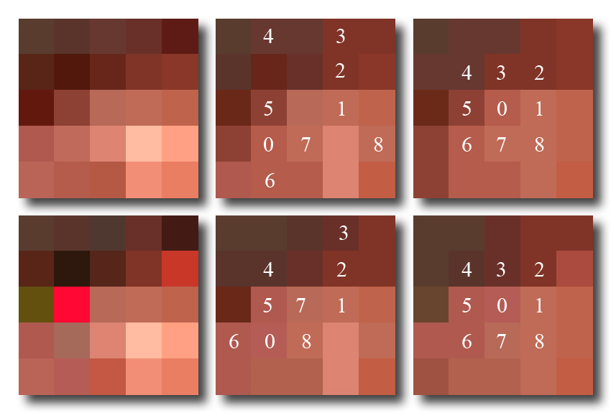
Color Median Filter
The output color at (r,c) is always selected from a nbhd of (r,c) in the input image.
original
3×3 MF
(3×3 MF)²
noisy
3×3 MF
(3×3 MF)²

Slide 34
Color Median Filter
The output color at (r,c) is always selected from a nbhd of (r,c) in the input image.
original
3×3 MF
(3×3 MF)²
noisy
3×3 MF
(3×3 MF)²

Slide 35
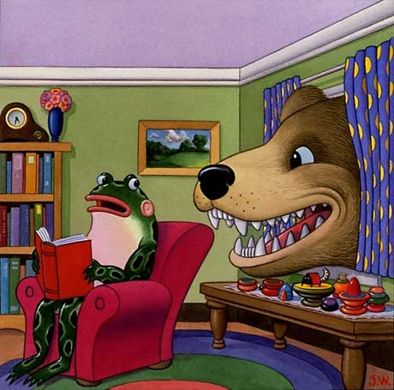
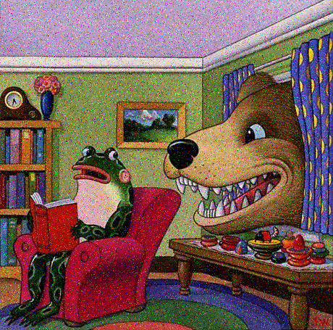
Color Median Filter
Jim Woodring – A Warm Shoulder
Sparse noise, 32% coverage in each band
www.jimwoodring.com

Slide 36


Color Median Filter
3×3 color median filter applied once
3×3 color median filter applied twice
original image: Jim Woodring
www.jimwoodring.com

Slide 37
Color Median Filter
Sparse noise, 32% coverage in each band
Jim Woodring – A Warm Shoulder
www.jimwoodring.com

Slide 38
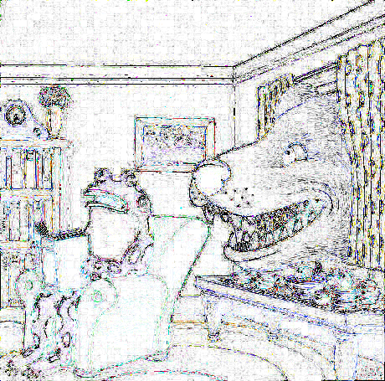
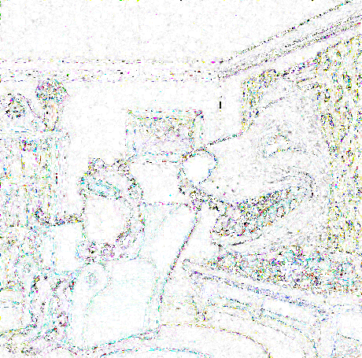
Color Median Filter
Absolute differences displayed as negatives to enhance visibility
(3×3 CMF² of noisy) – original
(3×3 CMF² of noisy) – (3×3 CMF² of original)
original image: Jim Woodring
www.jimwoodring.com

Slide 39
CMF vs. Standard Median on Individual Bands
A color median filter has to compute the distances between all the color vectors in the neighborhood of each pixel. That’s expensive computationally.
Q: Why not simply take the 1-band median of each color band individually?
A: The result at a pixel could be a color that did not exist in the pixel’s neighborhood in the input image. The result is not the median of the colors – it is the median of the intensities of each color band treated independently.
Q: Is that a problem?
A: Maybe. Maybe not. It depends on the application. It may make little difference visually. If the colors need to be preserved, it could be problematic.

Slide 40
CMF vs. Standard Median on Individual Bands
Jim Woodring – A Warm Shoulder
Sparse noise, 32% coverage in each band
www.jimwoodring.com

Slide 41
CMF vs. Standard Median on Individual Bands
3×3 color median filter applied once
3×3 color median filter applied twice
original image: Jim Woodring
www.jimwoodring.com

Slide 42


CMF vs. Standard Median on Individual Bands
3×3 median filter applied to each band once
3×3 median filter applied to each band twice
original image: Jim Woodring
www.jimwoodring.com

Slide 43
CMF vs. Standard Median on Individual Bands
Sparse noise, 32% coverage in each band
Jim Woodring – A Warm Shoulder
www.jimwoodring.com

Slide 44
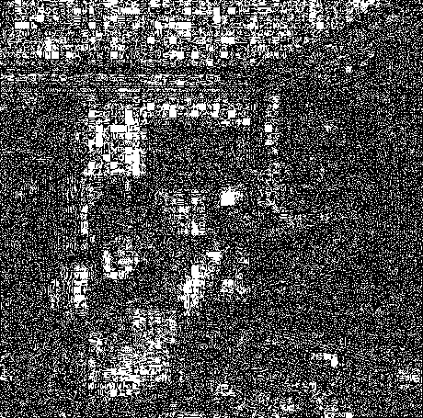
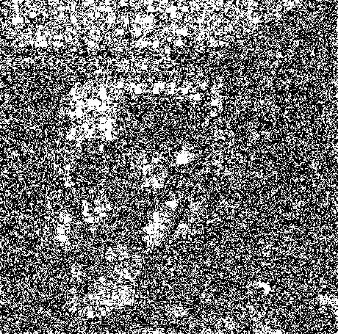
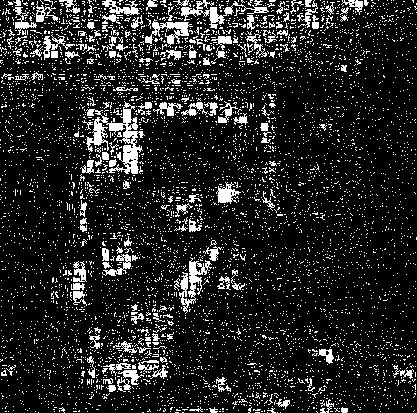
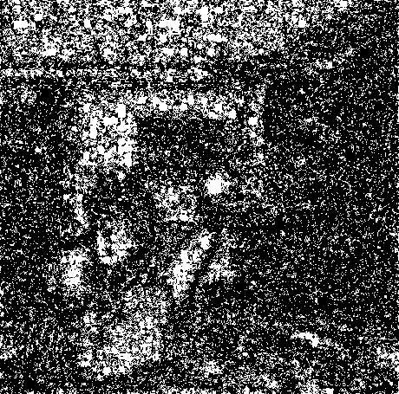
CMF vs. Standard Median on Individual Bands
Fraction of pixels in CMF² noisy image identical to original: 0.29
Fraction of pixels in CMF² noisy image identical to CMF² original: 0.43
Fraction of pixels in MF² noisy image identical to original: 0.14
Fraction of pixels in MF² noisy image identical to MF² original: 0.28
original image: Jim Woodring
www.jimwoodring.com

